Slide 1
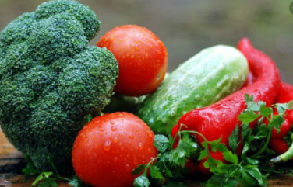
AFS Market Update
1/28/21

Slide 2
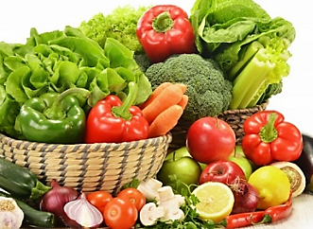
Veggies
Asparagus: Markets on both coasts have seen some relief over the last 10 days. Although weather in Caborca, Mexico is cooler, production is supposed to pick up significantly in the next weeks and continue through the months of February and March.
Bell Peppers: Acreage is down from previous years. Mexico will continue to produce volume and, weather permitting, should allow for promotional opportunities.
Broccoli: Supply out west has improved along with supplies from Mexico.
Bagged Salad: Supplies are increasing, and we have seen 90%+ fill rates from Dole for the last week and a half.

Slide 3
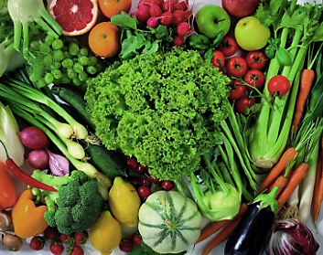
Veggies
Cabbage: Texas has product available. Watch for smaller sizing in the 18/20-count range after several weeks of cool weather.
Cauliflower: Moderate supplies with weights in the 37-40 lbs. Fields are showing good supplies on 9 ct. and limited on 12s. Long term expect good to moderate supplies.
Celery: Celery supplies have improved but production in the Southern California growing region has been hampered by rain and wet field conditions. Current quality reports are showing good color with occasional frost damage on the outer petioles. The weather forecast calls for average temperatures with a chance of rain towards the weekend.

Slide 4
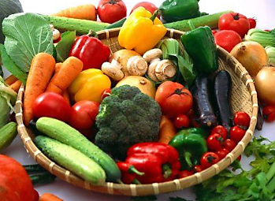
veggies
Cucumbers: Weak demand and good availability are keeping markets in check. Nogales will continue to produce decent volume, so we don’t see conditions changing in the upcoming weeks.
Lettuce: Iceberg and leaf lettuces remain plentiful this week with moderate demand. The weather forecast calls for average temperatures with a chance of rain toward the weekend. Overall quality reports show some blister and epidermal peel on the outermost leaves, but this has improved with less visibility in the finished pack. The primary shipping location for leaf items is Yuma, Arizona, and the Imperial Valley.
Squash: Harvesting in Mexico will resume this week, so expect volume to get back to normal. Weather permitting, we can expect to see promotional volume in two weeks.

Slide 5
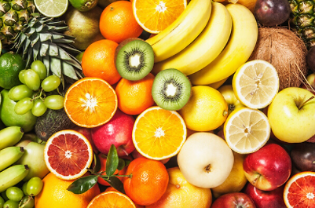
Fruit
Apples: The apple market remains tight again this week as demand remains strong. We expect this tight and higher priced market to remain this way for the next couple of months as inventories are less than last year at this same time. The tightest items are the Red Delicious, Golden Delicious, premium Honeycrisp, Granny Smith, and large Pink Lady apples.
Avocados: Volumes from Mexico have been increasing and avocado inventory in the USA has grown by roughly 18% versus the week prior. The inventory is heaviest to sizes 48s and 60s and should line up well with retailers pulling heavy this week for the upcoming Big Game. Inventory is rotating well, and quality has been excellent! The weather in Mexico is forecast to reach high temperatures in the low-90s during the days and mid-60s during the nights this week. There’s no rain in the forecast and harvest should continue to be strong. California growers have been experiencing heavy winds, rain, hail, and cold temperatures during the past few days. Volumes harvested have been very light so far.

Slide 6
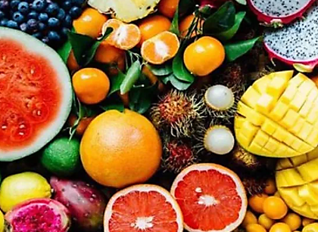
fruit
Blueberries: Demand exceeds supply, with a tightening market from both Chile and Mexico. Delays in arrivals and lesser picking with lesser crews available due to COVID is creating a lack of supply in the market and driving up demand. Expect the cost on blueberries to continue to go up from here to the end of the import season.
Blackberries: Demand exceeds supply, and the freeze in Mexico a few weeks ago is driving up the market on blackberries as less production is coming on.
Raspberries: Production is dropping as cold weather hits Mexico. Mexican high-altitude (1,500-2,000 meters above sea level) raspberries had extremely cold weather resulting in a high percentage of reduced crop. In some places, up to 60%; but, for the most part, between 30-40%. This does not look like it’s going to get any better any time soon.

Slide 7
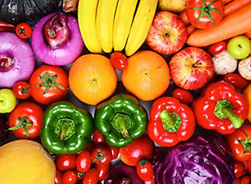
fruit
Cantaloupe: Cantaloupe arrivals on both Guatemalan and Honduran fruit continue mainly into Florida ports. Volume is light due to hurricanes at the beginning of the offshore season. Due to low yields and poor quality, growers are sending most product to Florida due to shorter transit time. Many shippers are repacking in Florida and therefore making arrivals for the most part. There is very little volume available after contracts are filled, and pricing is extremely high.
Navel Oranges: Navel demand has picked up over the last week. Pricing has also seen a spike as it is forecast to rain a lot over the next ten days. Supplies on small sizes have started to become limited and expect that to get worse as time goes on. Sizes are peaking on 56s/72s/88s. Exporting has been going strong and fruit is leaning strongly to fancy over choice. USDA programs have also started so expect to start seeing limited choice fruit and delays on bag times. Quality has been excellent, with great color. No longer gassing for color. Brix has been consistently over 11+ with many shippers over 12+.
Mandarins: Our suppliers have transitioned over to the Tango variety. Fruit should have good legs and great sugar.

Slide 8
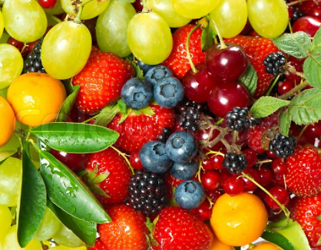
fruit
Grapes: Imported grapes out of Peru/Chile continue to arrive to both coasts into late January, with movement steady and market pricing remaining firm. Port delays in Long Beach have continued to plague the West Coast import grape supply though, with virtually all Peruvian containers taking anywhere from 10-14 days to release after arriving at Los Angeles. Variety-wise, a wide range of red seedless options (Allison/Sweet Celebration/Flame/Crimson) are still being shipped across a myriad of price points, with multiple green seedless varieties (Sugraones/Thompson/Sweet Globe/Arra 15) also still available.
Limes: Currently, the crop is peaking on 175/200/150s. The weather forecast is showing much better than the past two weeks and favorable for daily harvesting. The demand for limes has been high. Peak sizes are 175/200/230 with the following size distribution: 110-19%, 150-20%, 175-21%, 200-20%, 230-11%, and 250-19%. Several quality issues have been reported this week: lighter color, softer skin, and shorter shelf life. We are rounding the corner with the old crop. In a few weeks, expect to see smaller limes become available again.
Mangos: Volume out of Peru is starting to pick back up after a delayed start to the season. Expectations are that supply availability will improve going into February on the Kent variety coming from Peru. The quality of the fruit has been exceptional thus far with clean fruit, cutting with good internal color, and decent blush as well. The markets remain high this week and are not expected to drop significantly. The Mexican mango season continues to harvest Ataulfo/ (honey) mangos with limited supply. The sizing is currently peaking on 18 count.

Slide 9
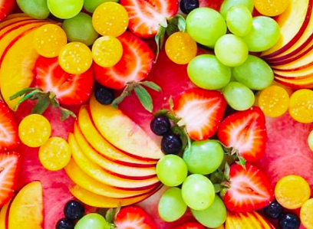
fruit
Pineapple: Additional Costa Rica supply is sufficient for the current demand and prices are remaining reasonably good. Not much surplus product at most shipping points with market fruit still selling quickly. Supply is improving out of Costa Rica with good quality fruit but some issues with ocean carriers struggling to get the additional supply exported.
Strawberries: Oxnard, California growing areas are experiencing limited supplies due to cold and inclement weather, and markets are very strong. This situation could last for several weeks so pre-books for Valentine’s Day should be placed (stem berries). Oxnard, California is forecast for cloudy skies, breezy conditions, and p.m. showers on Wednesday; Thursday is expected to become windier with rain, Friday with variable clouds and showers, Saturday mostly cloudy, and Sunday partly cloudy. Highs are forecast in the upper 50s increasing to the low 60s for the weekend, and lows in the 40s. Central Mexico is forecast for partly sunny Wednesday and Thursday, and full sun for the balance of the week. Highs are forecast in the 80s, increasing to the 90s on Sunday, and lows in the 40s. Oxnard, California fruit has good color, occasional pack bruising, white shoulders, and discoloration and scarring from the wind. Average counts are 18 to 20, occasionally higher and lower.

